Slide 1
Policy Proposals: City of Salisbury Recycling

Slide 2
Education and Advertising for Increased Recycling
Opportunities to improve City recycling offerings:
New “Recycle Right SBY”logo created by Ms. Kacey Martin, Salisbury Sustainability Advisory Committee Member
Stickers and Magnets promoting new logo
Distributing recycling bins with “Recycling Right SBY” logo
Placing recycling bins in the City’s public parks

Slide 3
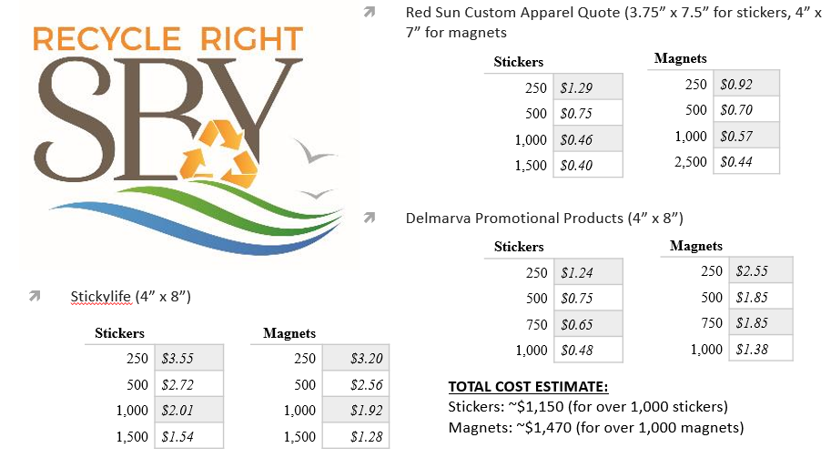
Stickers and Magnets
http://salisbury.md/recycleright

Slide 4
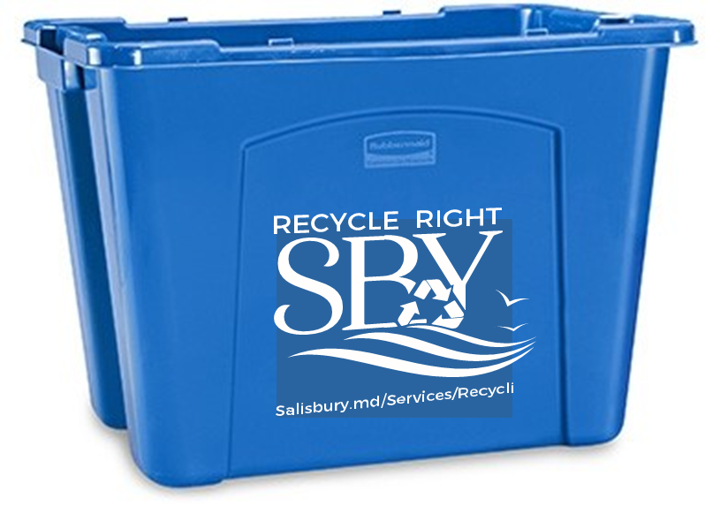
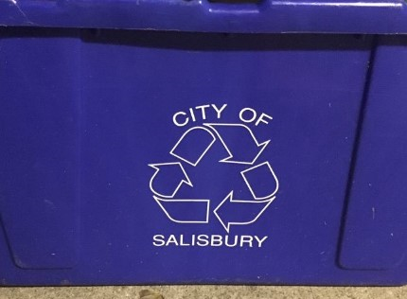
Recycling Bins with City Logos
New face/ logo for Salisbury recycling
Direct link to access to what can and cannot be recycled through Salisbury’s recycling program
Mock up created by Ms. Kacey Martin

Slide 5
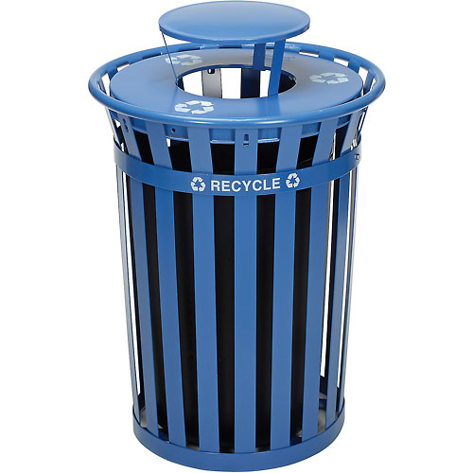
Installing City Park Recycling Bins
Public Space Recycling Program in Colorado Springs, Colorado (2011)
  Placed 90 recycling bins in 7 of the city’s large community parks/sports complexes
  Bins provided, installed, and maintained by Greener Corners, a public space recycling and environmental organization, for free
  In return, Greener Corners placed advertisements on the bins.
Oak Ridge Park, Michigan (2017)
  20 recycling bins installed in the City’s public park through the Recycling Bin Grant Program sponsored by the Dr. Pepper Snapple Group with Keep America Beautiful

Slide 6
Business Recycling
Problem: There is no official requirement for business to recycle.
Solution: Implement a business recycling program with which Salisbury businesses are required to comply.
Mandate: businesses must meet recycling requirements
Sticker: businesses will receive a sticker advertising they recycle
Website: offers resources to businesses about recycling

Slide 7
Business Recycling Mandate
Mandate Conditions: Businesses must comply with 1 or more of the following terms
Recycle 20% of the businesses generated waste
Recycle 2 different types of recyclable items
Provide options for consumer recycling; bins, etc.

Slide 8

Business Recycling Sticker
Complimentary sticker for businesses complying with the recycling mandate
Similar to the education and advertising group’s sticker

Slide 9
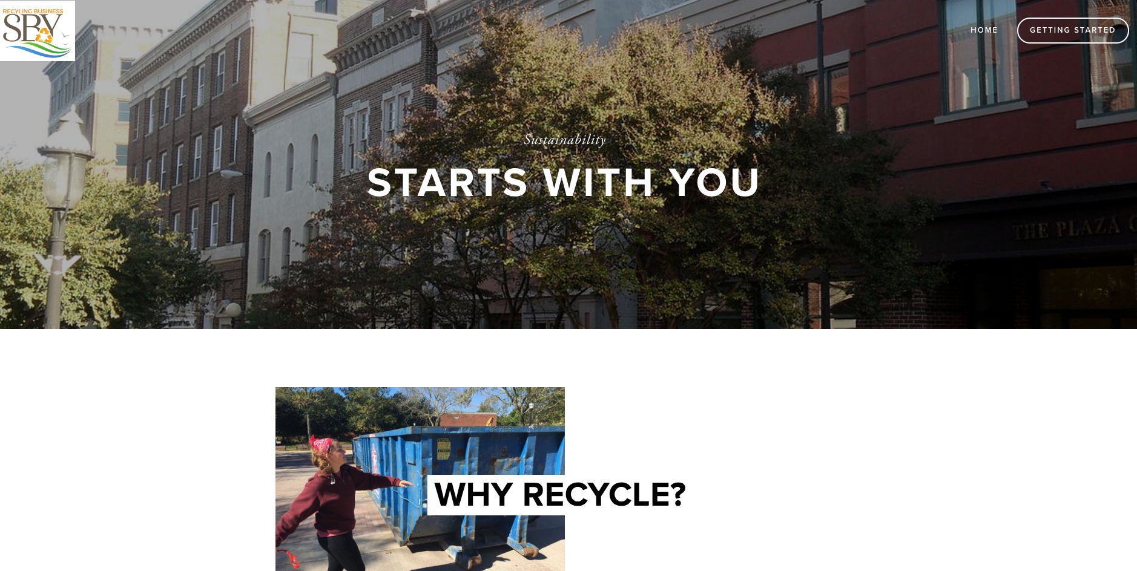
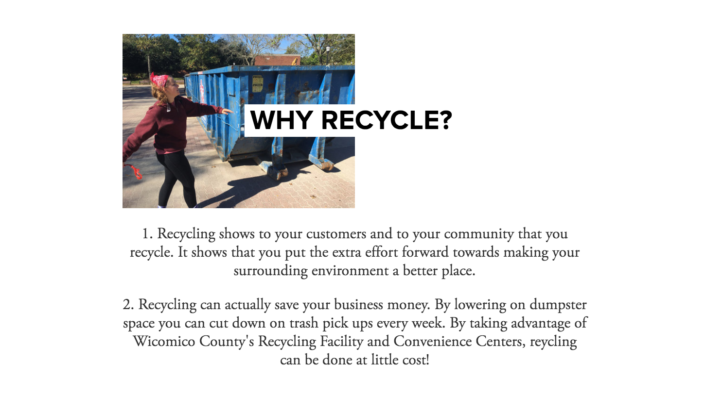
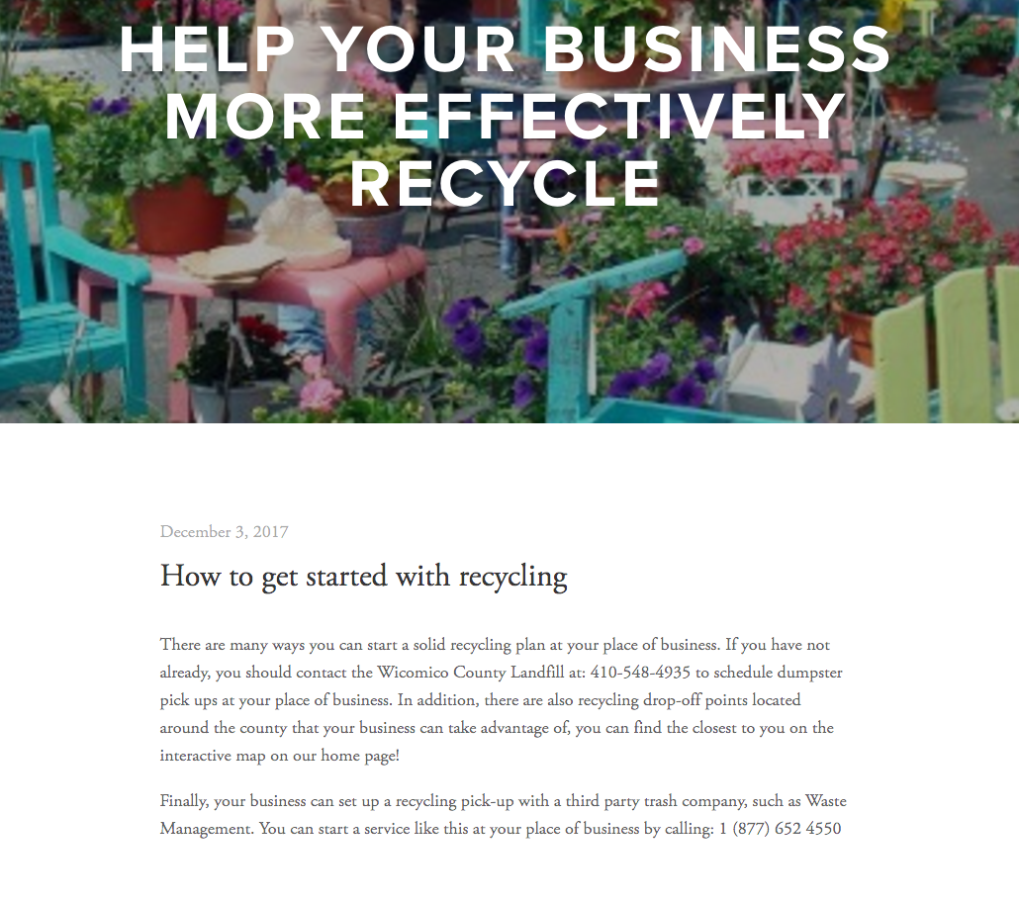
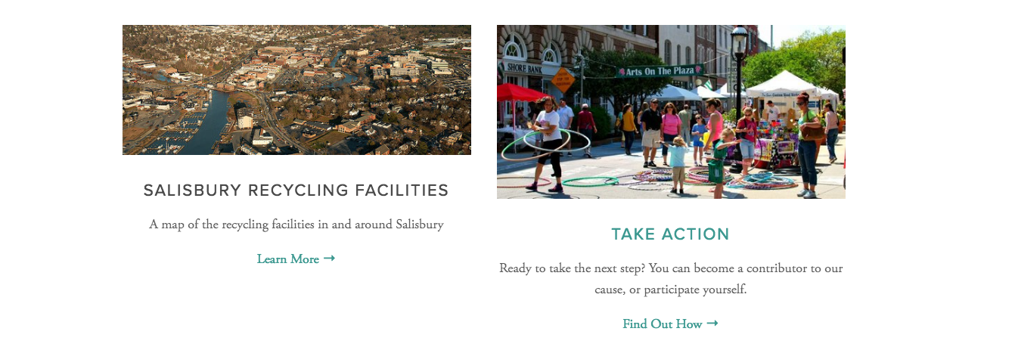
Business Recycling Website

Slide 10
National Folk Festival: Zero Waste Plan
Zero Waste is the diversion of non-hazardous waste from landfills through recycling, composting, reducing, and reusing.
Benefits:
Reducing garbage expenses
Diverting materials from entering the landfill
Reducing methane generation from landfills

Slide 11
3 Step Zero Waste Plan
  Waste stations will pair trash containers with recycling and compost bins
  The Green Committee will work with food vendors prior to the event
  Zero Waste volunteers will remove contamination from waste streams.

Slide 12
Reusable Souvenir Cup
Fundraising opportunity to support zero waste efforts
“Stadium style” flat graphic 32 ounce cup
  Graphics include: City of Salisbury, National Folk Festival, Zero-waste, and vendor logo
Dynamic Drinkware: Cup Company
  Order 5,000 cups min. $0.87 cents per cup
  Order 10,000 cups approx. $0.70 cents per cup
Sell cup for $5 and provide patrons with a “first free fill”

Slide 13
Policy Proposals: City of Salisbury Recycling
Education and advertising
Outdoor recycling options at city parks
Business recycling initiative
Zero waste National Folk Festival
For more information and to view our policy briefs visit www.salisbury.edu/pace/recycleright.html

